Slide 1




Create, implement and evaluate strategic product initiatives
D2.TCS.CL5.07
Notes:
Trainer welcomes students to class.

Slide 2
Element 1: Create strategic product initiatives
The performance criteria for this element are:
1.1 Identify the context for product development
1.2 Undertake market research on identified opportunities and identified target markets
1.3 Determine product life cycle issues that apply to identified opportunities and products
1.4 Determine financial issues that relate to the development of product initiatives
1.5 Research product development opportunities that align with the context that applies
1.6 Develop product development plans reflecting research information and business objectives
1.7 Produce the identified product or service initiative
Notes:
Trainer should go through the assessment and expectations of the course. Trainer should draw trainees’ attention to work projects and due dates.

Slide 3

1.1 Identify the context for product development
The business context in which an organisation operates can involve many varying aspects. It is important to understand and analyse the business environment as a whole to determine what factors may impact upon new product or service development.
Notes:
Class Activity – Discussion
Trainer to provide examples

Slide 4

The Marketing Mix
Notes:
Trainer to explain the marketing mix and also the external environment surrounding the marketing mix.
The Four P’s
Price
The price aspect of the marketing mix refers to the value of an organisation’s products and service. Some of the factors that influence price may be the cost to make or deliver the product or service, discounting strategies, and positioning in relation to competitor pricing.
Product
These are the goods and services that an organisation offers to its customers or consumers. Products and services have both tangible and intangible aspects and services are often intangible in that you can’t see, touch or feel the service, only the effect of it or impression.
Place
This refers to how and where the product or services are being delivered to customers. The place where product or service delivery occurs has a significant impact on deciding to develop or deliver a service. Place is sometimes referred to as distribution and includes location, facilities, and whether other intermediary partners are needed.
Promotion
Promotion relates to how customers are informed about the product or service and includes advertising, sales promotion, public relations and personal sales.
These four marketing variables operate within an external environment which includes competitive, political and legal, technological, social, and economic factors. All of these components influence the type of products and services that your organisation will develop.

Slide 5
External product environment
Competition
Political and Legal
Economic
Technological
Social
Notes:
Trainer explains each external factor and provides an example of each area. Trainees can draw from the TM.
Activity: Participants could think of a product within their organisation and outline an example of each component of the marketing mix and how it may affect the product/service.

Slide 6
SWOT Analysis
Strengths
Weaknesses
Opportunities
Threats
Notes:
Trainer explains the four components of the SWOT Analysis. Trainer asks students to explain why a SWOT analysis is important to conduct.
Trainees read through the TM and identify examples of each component.
Activity: Trainees think about their organization and identify examples of each area of the matrix within their organization. Which examples are internal and external?

Slide 7
BCG Matrix
High
Low
High
Star
Question Mark
?
Relative Market Growth Rate
Low
Cash cow
Dog
$
Relative Market Share
Notes:
Trainer explains the Boston Consulting Group Matrix:
Another matrix that is used to determine what products and services are successful or not is the Boston Consulting Group Matrix. This is similar to a SWOT analysis but identifies business performance areas to improve, cease or develop. Stars are the products, services or business lines that are performing well and they should be promoted and encouraged to grow. Cash cows are the services and products that consistently produce good results and are often the core business. The revenue that they produce is used to fund Stars and potential question marks. Question marks are the products and services that an organisation is not sure about. It is important to analyse why these business lines are not performing as well as expected and a decision needs to be made whether to continue or cease these products and services. Dogs are under-performing products and services and they should be stopped.

Slide 8

1.2 Undertake market research on identified opportunities and identified target markets
Notes:
Trainer explains the importance of identifying targets and objectives for marketing activities.
Objectives should also follow the SMART rule in that they should be:
Specific, Measurable, Achievable, Realistic, Time-based
In developing market research objectives it may be helpful to ask:
What is the organisation’s overall strategy?
How does the organisation work to achieve these goals?
What resources are available or needed to undertake the market research?
Are the objectives achievable and realistic?
What are the timeframes for market research activities?
What finances or budget are required?

Slide 9

Collecting data
Notes:
Trainer explains the need for collecting relevant data that could assist with new product or service development. Relevant data should be collected from various sources and may include Primary and Secondary data. . Data can be classified as primary and secondary where primary data is collected for a specific designated reason and secondary data is previously gathered information that may be relevant and useful for another purpose. Trainer highlights the challenges associated with collecting primary data.
Activity: Trainees provide examples of marketing data that is gathered within their organisations and determine if it is primary or secondary data.

Slide 10

Secondary data
Some questions that could lead market research are:
Have sales gone up or down?
What could have affected sales results?
Which market segments or products have performed well? Why/Why not?
What are the relative costs of a product or service?
Are these acceptable/increasing/decreasing? Why?
What other factors impact on the cost of product or service delivery?
Is the service or product profitable?
Do customers need or want the service or product? How do we know?
Are customers happy or satisfied with an existing service or product?
Notes:
Trainer asks “How does your organization answer these questions?”
Trainees provide some possible answers and examples from their workplace.

Slide 11

Quantitative and Qualitative Data
Notes:
Trainer explains the difference between the two data collection techniques. Data collection techniques could draw upon quantitative or qualitative data. Quantitative data is numerical, statistically reliable and applicable to a broader context. Qualitative data is non-numerical, in-depth and directional in that it can show where to go with product or service development. Once the research methods have been chosen, the data must be gathered. Secondary sources of data should be collected first and then a decision needs to be made as to whether primary data is also needed

Slide 12
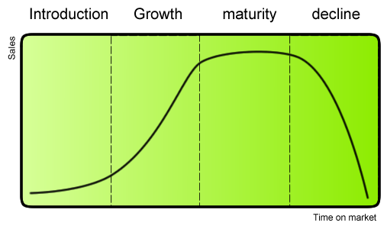
1.3 Determine product life cycle issues that apply to identified opportunities and products
Notes:
Trainer explains the graph relating to product life cycle.
The product life cycle theory outlines how a product or a service moves from its original beginning as an idea, through development and implementation, to potential decline. The stage at which a product or service is at within the product life cycle can impact on what strategies are required to positively influence the product or service which could lead to reinvesting in the product or even ceasing delivery or offering of it.

Slide 13

Product life cycle
Introduction
At the introduction stage, a product or service has been through planning and development processes and is now ready to be launched. The product or service has been tested, analysed and market research has been conducted.
Notes:
Trainer goes through the slide with trainees. As can be seen in the graph in the previous slide, the initial introduction phase may not result in significant sales as the product or service needs to become known by the market.

Slide 14

Product life cycle
Growth
At this stage, the customer base grows and more people become aware of the product or service. Sales increase significantly and profit should increase as well. Some small adjustments may need to be implemented at this stage, but the customer uptake of the product or service will continue to increase at the growth stage.
Notes:
Trainer introduces slide and discusses the growth stage. Trainer explains that the amount of growth and the duration of growth is not fixed and it may continue for a long time or it may be quick and steep but then plateau.

Slide 15

Product life cycle
Maturity
After the growth stage, a product or service may cease to grow and sales may just level off. At this point in the market life cycle, the customer base may have reached its highest level and there is no room for increased market penetration if the product or service remains the same. Often competition has increased at this stage and the market has become saturated with providers or organisations offering the same or similar products and services.
Notes:
Trainer goes through slide and presents the information below:
At the maturity stage, an organisation may look at ways to show customers how their product or service is unique from competitors, in an attempt to persuade customers to switch from a competitor to its product. There may also be a need to keep current customers so marketing campaigns may be developed to maintain the existing market share. Many products and services stay at the maturity stage and may not transition to the next stage.

Slide 16

Product life cycle
Decline
In the final stage of the cycle, a product or service’s sales and profits begin to decline. There may be many competitors in the market at this point and discounting has become more prevalent. At this point, an organisation may need to lower costs in delivery by reducing customer service levels, staffing, effort and marketing or promotion and the existing loyal customers may be all the organisation is focused on maintaining. Some competitors may cease delivery or offering of a service or product at this stage so there may be opportunities to attract customers from competitors.
Notes:
Trainer goes through the information with trainees. Activity: trainer asks trainees to identify a product in their organization and determine where in the product life cycle it is. How do they know? What could be done to extend the life of the product or service?

Slide 17
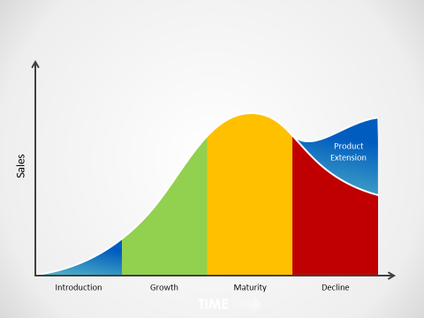
Utilising the product life cycle
Notes:
The product life cycle as a tool
In order to take advantage of the product life cycle, it is necessary to identify where a product or service is at within the cycle and to examine competitor products and services within the four stages. It is possible to extend the product life cycle by increasing sales to current customers through encouraging them to buy more or to purchase more often.
It is possible to apply market penetration strategies to increase the amount of customers by attracting new customers to purchase the product or service. This may be difficult if there is growing competition and investment may be needed, but there may still be an opportunity to increase market share. For example, a hotel or resort may realise that there are local customers interested in using the facilities and the organisation may offer a special rate for local residents to use the gym, pool and offer discounts for food and beverage purchases.
Finding new uses for the existing product or service is also a potential opportunity to increase sales and extend the product life cycle. Different uses for a product or service may be discovered and promoted by the enterprise or it may be as a result of customer feedback.

Slide 18

1.4 Determine financial issues that relate to the development of product initiatives
Some questions relating to finances that need to be considered include:
How much will the product or service cost to develop and implement?
What funds are available within the organisation or externally to support the product initiative?
What is the organisation’s current cash flow situation and is there enough cash available to support the initiative?
Are there additional funding opportunities from partners, stakeholders, government bodies, grants or financial incentives available?
Are there any tax or increased cost affects relating to the product or service development?
Notes:
Trainer introduces financial issues and explains that there are many aspects that need to be considered when developing and introducing new products and services. One of the most important factors to consider is financial issues that may affect product or service development. It may be determined that there is an opportunity to develop a new product or service but if the required funding is not available introducing the new item may not be viable. It is critical to examine all of the financial issues that may impact on new product or service initiatives.

Slide 19

1.5 Research product development opportunities that align with the context that applies
Notes:
Trainer explains the need to align business opportunities with the actual business context. Identifying business opportunities can be a challenging activity and it is important to utilise all available information and data before beginning a product development plan. Opportunities may be determined by a change in the external environment where an organisation sees a gap in the market place or a need that isn’t being met. Opportunities could also be identified by existing customers or by staff but it is necessary to determine what benefits new products may bring and whether they are feasible within the organisation’s context. The SWOT analysis will often provide a general idea of opportunities that could be targeted and further investigation is needed to decide if there is an opportunity to develop a new product or service.

Slide 20

Researching opportunities
After identifying potential business development opportunities, it is important to gather information and input from relevant sources. These sources could include:
Visits or experience of competitor products and services
Encouraging input from relevant stakeholders including staff, colleagues, local communities, existing customers, authorities, industry professionals and suppliers
Investigation and analysis of cost-benefits and increased revenue opportunities related to product development and introduction
Identification of gaps that may exist within the organisation and determining what resources are needed to successfully implement a new product or service
Conducting market research activities to identify potential customer response to new product or service development
Notes:
Trainer explores the slide with trainees. The data collected from within the organization could provide an idea where opportunities are. For example, a staff member may have experienced a competitor’s product or service and identified it as a potential opportunity within their own organization.

Slide 21
1.6 Develop project development plans reflecting research information and business objectives
Generate idea
Screen product or service
Outline and test the concept
Analyse business potential
Market test the product or service
Introduce to the market
Notes:
Trainees read through the TM. Trainer utilizes information from the TM to elicit from trainees the need to generate good ideas for new products based upon evidence and perhaps a set of criteria as in the TM. Trainer goes through the phases in this slide and explains the activities at each stage.

Slide 22
Marketing plan
Executive summary
Vision and mission
Situation analysis
Marketing objectives
Marketing strategy
Financials
Implementation, evaluation, and control
Notes:
Trainer explains that a marketing plan may also have to be developed as a part of the product development plan. There are many examples of marketing plans on the internet and it may be helpful to elicit trainees knowledge of marketing plans. Brainstorm with the class the different parts of the marketing plan and ask them if they have been involved with developing a marketing plan before.

Slide 23

1.7 Produce the identified product or service initiative
When developing a new product or service, it is important to utilize all of the information previously gathered.
Notes:
Trainer explains the importance of drawing upon all previous information and data that has been gathered in order to produce a product or service that is effective. Ask students to brainstorm all of the information that might be relevant to producing a product or service. What type of information is needed? (Social, political, legal, environmental etc.)

Slide 24

Product or service production
In producing a product or service there are some factors that should be considered including:
Who will be in charge of the process?
What resources are available or needed?
What facilities or technology are required?
How will the product be priced?
What training might be needed?
Are there any suppliers or partners needed?
When will the product or service be launched?
Notes:
Trainer goes through the slide and explains the content. Ask students to think of a product or service in their organization, and answer the questions in the slide for that product or service. Trainer elicits answers and extends responses.
Activity:
Think of a product or service within your organisation and outline all of the people involved in the delivery or offering of the product or service. What equipment, items, materials, and facilities are needed for the product to be accessed?

Slide 25
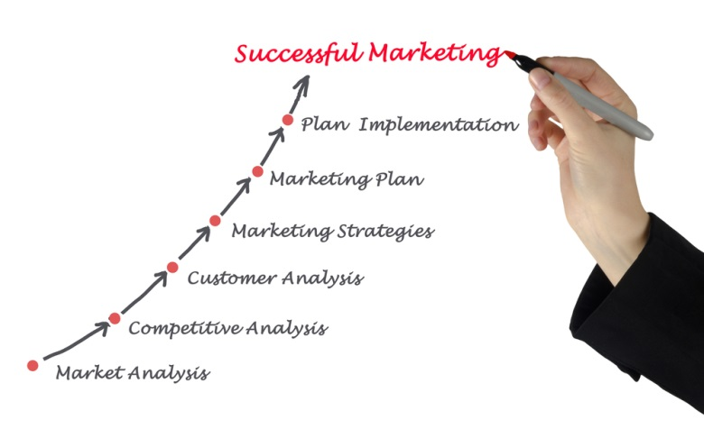
Element 1: Summary
The product or service creation stage is the first step in the process and allows for a product or service idea to become a reality. In creating a new product or service it is important to:
Identify and examine the context in which the initiative will occur
Conduct market research
Identify the product life cycle stage and explore the implications for a new product or service
Determine any financial issues that may affect the initiative
Develop the product or service development plan and produce the item
Notes:
Trainer goes through the summary and asks if there are any questions. Trainer should check if work projects have been completed.

Slide 26
Element 2: Implement strategic product initiatives
Performance criteria:
2.1 Trial the initiative in accordance with established plans
2.2 Revise the initiative as required on the basis of operational matters and customer feedback
2.3 Monitor the introduction and implementation of the initiative
2.4 Apply change management skills to facilitate the introduction and establishment of the initiative
2.5 Promote the initiative to customers
Notes:
Trainer introduces the element and goes through the performance criteria with the group. Trainer explains work projects for this element and due dates.

Slide 27

2.1 Trial the initiative in accordance with established plans
Trialing a new product or service is important in order to:
Check the process or activity is ok
Identify areas for improvement or issues
Check staff skills and knowledge
Check equipment or technology
Notes:
Trainer goes through the information with trainees

Slide 28

Market testing
Some ideas for introducing a new product or service could include:
Testing a new menu on some loyal customers and staff or trialling at a private function
Give people a free sample of a product if they complete a questionnaire about it
Develop an online video or explanation of the product or service and send to existing customers/staff for feedback
Invite staff or family and friends of staff to trial the product or service and then ask for feedback
Notes:
Trainer elicits the importance of market testing. It is important to see if the product or service is easily delivered, used, purchased, maintained, and are there any issues or problems? Ask students to brainstorm some ways for introducing a new product or service. What have they done or experienced before? It could be for a product from a competitor or a different industry.

Slide 29

2.2 Revise the initiative as required on the basis of operational matters and customer feedback
Gathering feedback is an important part of the product trial process as it enables modifications to be made before the product or service is officially launched. Feedback could be gathered from:
Staff
Customers
Suppliers
Owners
Management
Notes:
Trainer explains the importance of gathering feedback. Feedback needs to come from a variety of sources and it needs to be analysed in order to determine possible revisions that may need to be made to the product or service. Trainer asks trainees how feedback is gathered within their organisations and asks students to give examples of changes that have been made to products or services due to feedback.

Slide 30

Product or service revisions
Revisions may be necessary due to:
Operational issues such as staff levels, staff skills and training needs, required equipment
Customer likes, dislikes, perceptions and feedback
Staff feedback concerning product or service delivery issues
Supply issues
Cost issues
Timing issues
Product look or design
Product or service delivery processes
Notes:
Trainer elicits reasons why product or service initiatives may need to be altered. It is important to understand that no matter how well you plan, there is often something that has not been considered and trialling the product allows issues to be identified and rectified. Ask students to think of examples of the issues presented in the slide.

Slide 31
2.3 Monitor the introduction and implementation of the initiative
Feedback regarding the introduction of a new product or service can come from many sources but it is important that a system has been developed to collect feedback.
How is feedback collected in your organization?
Notes:
Trainer introduces the slide and asks students to share feedback sources in their organization.

Slide 32

Feedback survey
Activity
Think about a product or service you use regularly, and complete the survey by circling the appropriate response. Discuss any ideas with your group.
Notes:
Trainees read the information in their TMs and complete the survey activity. Trainer asks trainees to share their responses and experiences. How do they monitor product and services in their workplace? What changes were made to a product or service due to feedback?

Slide 33
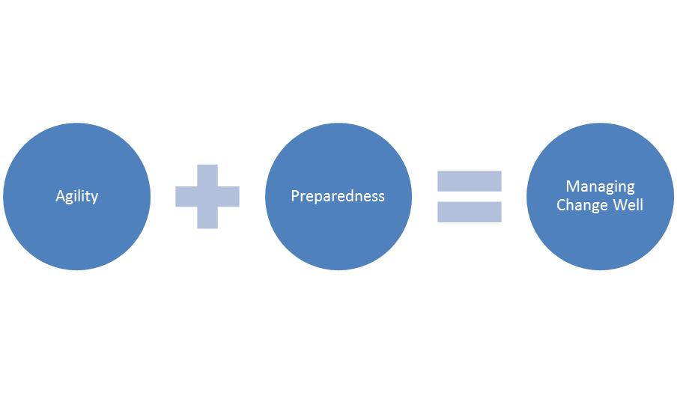
2.5 Apply change management skills to facilitate the introduction and establishment of the initiative
Change is often difficult for people to accept and introducing a new product or service may require staff and customers to change their habits or routines. It is important that change is handled effectively and carefully in order to avoid resistance.
Notes:
Trainer explains the idea of change management and how change is often difficult to implement effectively. Trainer explains the picture in the slide which highlights agility or flexibility and preparedness as important to implementing effective change. People/staff/customers need to have a positive attitude to change and it is important for the organization to create this attitude. Trainer asks students to provide examples of poor change management skills that they have experienced. Trainer asks “What made the change fail?” Possible answers could be a lack of clear communication, rushing, not gathering enough feedback and responding to it.

Slide 34

New product or service change issues
Introducing a new product or service may require management and supervisors to:
Alter Standard Operating Procedures and explain these changes to staff
Train staff and provide opportunities to practice delivering the new product or service
Support staff during the introductory stage of the initiative by informing staff about what support is available and how to access it
Change staff resource structures and teams
Communicate progress and highlights/issues to staff and stakeholders
Help staff overcome resistance to change
Notes:
Trainer goes through the examples with students and asks students to provide examples of any of the items in the slide.

Slide 35

Kotter’s 8 step change model
Increase urgency – Inspire people to move, make objectives real and relevant.
Build the guiding team – Get the right people in place with the right emotional commitment, and the right mix of skills and levels.
Get the vision right – Get the team to establish a simple vision and strategy, focus on emotional and creative aspects necessary to drive service and efficiency.
Communicate for buy-in – Involve as many people as possible, communicate the essentials, simply, and to appeal and respond to people's needs. De-clutter communications: make technology work for you rather than against.
Continued
Notes:
Trainer goes through Kotter’s model for change using information from the TM. Trainer can use information from www.kotterinternational.com.

Slide 36

Kotter’s 8 step change model
Empower action – Remove obstacles, enable constructive feedback and lots of support from leaders – Reward and recognise progress and achievements.
Create short-term wins – Set aims that are easy to achieve – In bite-size chunks. Manageable numbers of initiatives. Finish current stages before starting new ones.
Don't let up – Foster and encourage determination and persistence – Ongoing change - encourage ongoing progress reporting – Highlight achieved and future milestones.
Make change stick – Reinforce the value of successful change via recruitment, promotion, new change leaders. Weave change into culture.
Notes:
Trainer goes through Kotter’s model for change using information from the TM. Trainer can use information from www.kotterinternational.com.

Slide 37
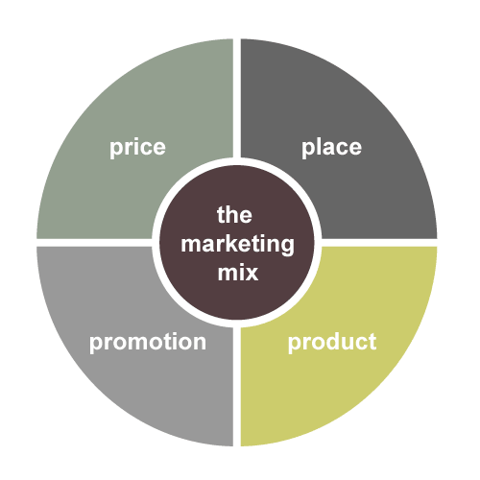
2.5 Promote the initiative to customers
Notes:
Trainer explains the marketing mix and uses the TM to identify examples of the promotional mix.
It is important to ask:
How can the product or service be promoted? Where and when can you inform customers of the new product or service?
What advertising media will be used? Will it just be internally generated through brochures, verbal notification to customers, email, website, banners, social media or events?
When is the best time to promote to your customers?
How do your competitors promote their products and services, and are they effective strategies?
What types of promotional activities have already proved successful within your organisation?
What budget is available for promotional activities?

Slide 38

Promotion ideas
Some ideas could be:
Hold a product launch event
Create brochures, flyers and posters and distribute
Website news, emails to customers, social media news release
Discounts for early buyers
Free trials
Newspapers, web banners, TV, press releases
Attend trade/industry shows and distribute information
Utilise customer testimonials
Notes:
Trainer asks trainees to provide examples of promotional ideas that they are aware of. Trainer could bring in examples of different promotional campaigns from well known brands. Trainer could asks students to look at a competitor’s promotional strategies and identify what they are doing and how this differs from their own organization. Trainer could show this video (Science of persuasion) or use Dr. Cialdini’s ideas on the science of persuasion. https://www.youtube.com/watch?v=cFdCzN7RYbw

Slide 39

Element 2: Summary
Implement strategic product initiatives
It is not effective to rush and introduce a new initiative without testing the product or service first
It is important to trial the new product and to gather feedback from relevant people in order to see if there are any changes that need to be made
Gathering feedback from many different stakeholders is necessary
When changing a product or service, it is important to inform or the relevant people and to communicate the changes clearly
Notes:
Trainer summarises the element and reminds students of work projects and due dates.

Slide 40
Element 3: Evaluate strategic product initiatives
Performance criteria:
3.1 Record statistical data to enable evaluation against Key Performance Indicators to occur
3.2 Solicit and record feedback from stakeholders
3.3 Compare projected outcomes against actual outcomes
3.4 Determine and implement changes, if any, that need to be made to maintain or revise the initiative
Notes:
Trainer introduces the element and goes through housekeeping with the trainees. Trainer informs students about work projects and due dates.

Slide 41

3.1 Record statistical data to enable evaluation against Key Performance Indicators to occur
Notes:
Trainer explains the importance of collecting data and statistics that can help to determine the performance of a new product or service. It is necessary to compare statistics against KPIs to see if the product is reaching the goals that were outlined. Ask students to provide examples of statistics that may be useful for evaluating product or service performance: financial data, increases in customer numbers/sales, cost reductions

Slide 42

Examples of statistics
Data and statistics that may be applicable for analysing product or service performance could include:
Cost information: product costs, delivery costs, staff costs, facility and equipment costs, training costs, maintenance and repair costs, supplier costs
Revenue data including total revenue and profit/loss statements
Visitor or user numbers
Booking and reservation numbers
Number of enquiries received
Number of responses generated
Customer feedback survey response numbers and responses
Notes:
Trainer goes through examples with trainees and elicits other examples from the group. What KPIs does their organisations set in regards to these examples?

Slide 43

3.2 Solicit and record feedback from stakeholders
Notes:
Trainer explains the need for effective feedback gathering. Feedback needs to be collected from a variety of sources and should be collected regularly. It is important for an organisation to develop a culture where feedback is encouraged and actively sought rather than gathered randomly and inconsistently. Documenting feedback is also important in order to be able to monitor responses over time. Trainer explains that stakeholders could include many different people from managers, owners and suppliers, to staff and customers.

Slide 44

3.3 Compare projected outcomes against actual outcomes
Notes:
Trainer elicits the need for evaluation of results or performance. If projected outcomes do not match actual outcomes then there needs to be an analysis of why the outcomes do not match. This may be due to a change in the business environment or context which differed from when the product plan was developed. The actual outcomes could be better or worse than predicted but either way there must be an examination of the performance.

Slide 45
Net Promoter Score (NPS)
‘How likely is it that you would recommend [your company/service/product] to a friend or colleague?’
The rating is out of 10 and:
Promoters rate at (9-10),
Passives at (7-8)
Detractors (0-6).
Notes:
Trainer explains what the Net Promoter Score is and asks if students have seen or if their organisations use this rating system. There is an example in the TM that could be used to elicit NPS.

Slide 46
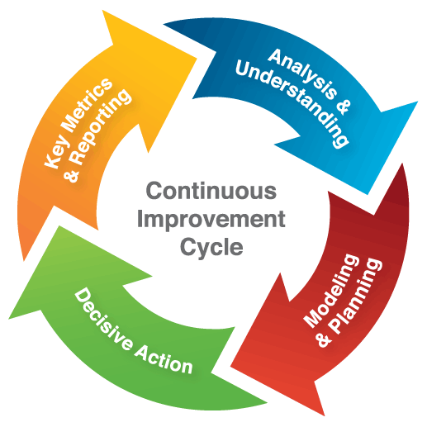
3.4 Determine and implement changes, if any, that need to be made to maintain or revise the initiative
Notes:
Trainer explains what a continuous improvement cycle is and involves. Based upon previous units trainees should be able to explain what is needed to be done in order to maintain an effective product development process. If there are issues or successes identified it is necessary to respond to this information and alter the product or service to improve the initiative. Trainees read the TM and look at some areas that may require change. Trainees provide examples of changes that have been implemented within their work context regarding new product and service initiatives. Trainer asks what prompted the changes?
Trainer reminds students of work projects and due dates.

